Slide 1








Combustion Regime-Independent Sub-grid Turbulent Combustion Model for Accurate Numerical Simulations of High-speed Turbulent Reacting Flows
Fernando Illacanchi^{1,3,*}, Andrés Z. Mendiburu², Cesar Celis¹
¹Mechanical Engineering Section, Pontificia Universidad Católica del Perú, Lima, Peru
²Universidade Federal do Rio Grande do Sul, Porto Alegre, Brazil
³Technical University of Munich, TUM School of Engineering and Design, Garching, Germany
*f.illacanchi@pucp.edu.pe

Slide 2
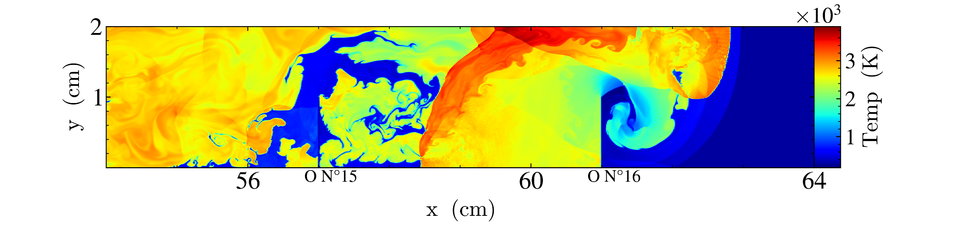
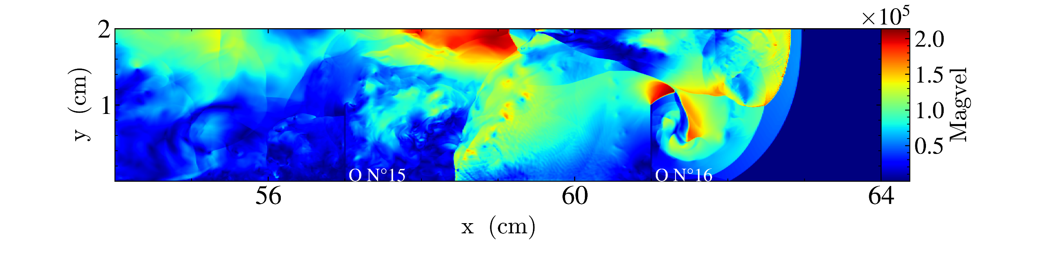
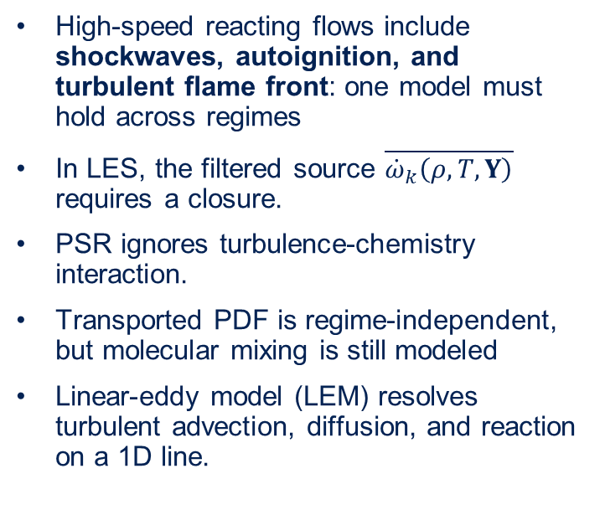
Motivation
High-speed reacting flows include shockwaves, autoignition, and turbulent flame front: one model must hold across regimes
In LES, the filtered source $\overline{{\dot{ω}}_{k}\left(ρ,T,Y\right)}$ requires a closure.
PSR ignores turbulence-chemistry interaction.
Transported PDF is regime-independent, but molecular mixing is still modeled
Linear-eddy model (LEM) resolves turbulent advection, diffusion, and reaction on a 1D line.
High-speed flame propagation in an obstructed channel

Slide 3


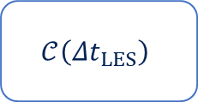
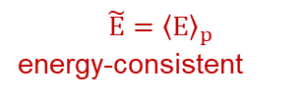


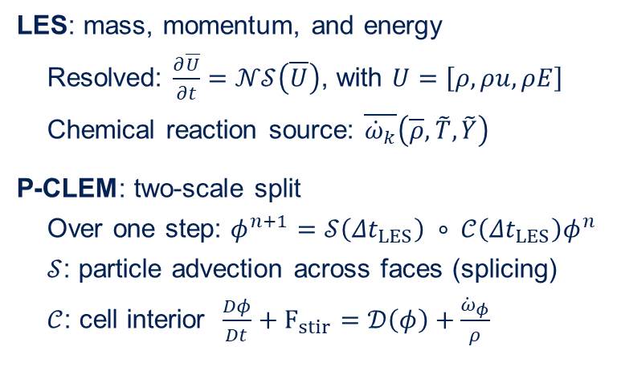
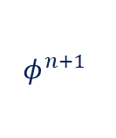


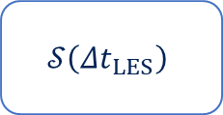
Governing equations
LES: mass, momentum, and energy
Resolved: $\frac{∂\overline{U}}{∂t}=𝒩𝒮\left(\overline{U}\right)$, with $U=\left[ρ,ρu,ρE\right]$
Chemical reaction source: $\overline{{\dot{ω}}_{k}}\left(\overline{ρ},\tilde{T},\tilde{Y}\right)$
P-CLEM: two-scale split
Over one step: $φ^{n+1}=𝒮\left({Δt}_{LES}\right) ∘ 𝒞\left({Δt}_{LES}\right)φ^{n}$
$𝒮$: particle advection across faces (splicing)
$𝒞$: cell interior $\frac{Dφ}{Dt}+F_{stir}=𝒟\left(φ\right)+\frac{{\dot{ω}}_{φ}}{ρ}$
LES
$${\overline{U}}^{n}$$
$${\overline{U}}^{n+1}$$
$$𝒩𝒮\left(\overline{U}\right), {Δt}_{LES}$$
$$\overline{U}, Δ, {Δt}_{LES}$$
$$\tilde{E}={\left\langle E\right\rangle }_{p}$$
energy-consistent
$$\overline{{\dot{ω}}_{k}}\left(\overline{ρ},\tilde{T},\tilde{Y}\right)$$
P-CLEM
subordinate
to LES
$$φ^{n}$$
$$𝒞\left({Δt}_{LES}\right)$$
$$𝒮\left({Δt}_{LES}\right)$$
$$φ^{n+1}$$
Flowchart for LES – CLEM numerical simulation

Slide 4
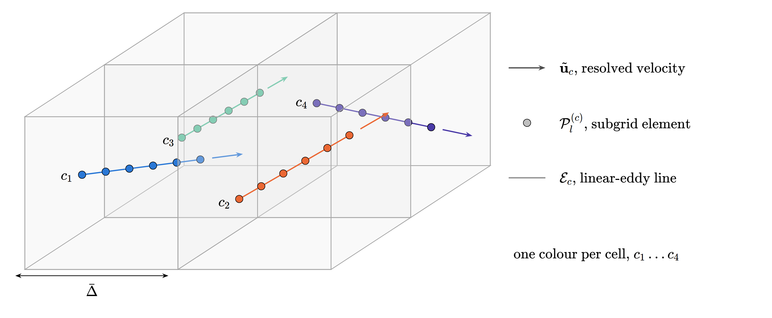
LEM Representation
Each LEM domain is an ordered particle ensemble carrying T, Y, mass, volume, and pressure.
Mass coordinate: thermal expansion is intrinsic
Built on AMReX particles in PeleC, allowing scalability.
Computational representation of the particle ensembles in a LES cell. Particle ensembles are oriented in the flow direction.

Slide 5
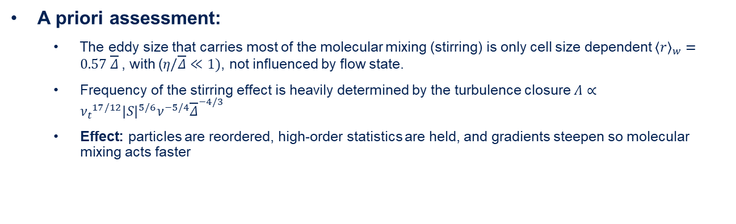
Stirring and resolved field effect
Before stirring: particles ordered 1–16
1
2
3
4
5
6
7
8
9
10
11
12
13
14
15
16
1
2
3
4
5
8
11
12
9
6
7
10
13
14
15
16
After stirring
$${\left\langle r\right\rangle }_{w}=0.57 \overline{Δ}$$
Stirring effect on a particle ensemble. Stirring is a permutation of particles enhancing scalar gradients.
A priori assessment:
  The eddy size that carries most of the molecular mixing (stirring) is only cell size dependent ${\left\langle r\right\rangle }_{w}=0.57 \overline{Δ}$, with ($η/\overline{Δ}≪1)$, not influenced by flow state.
  Frequency of the stirring effect is heavily determined by the turbulence closure $Λ∝{ν_{t}}^{17/12}{\left|S\right|}^{5/6}ν^{−5/4}{\overline{Δ}}^{−4/3}$
  Effect: particles are reordered, high-order statistics are held, and gradients steepen so molecular mixing acts faster

Slide 6
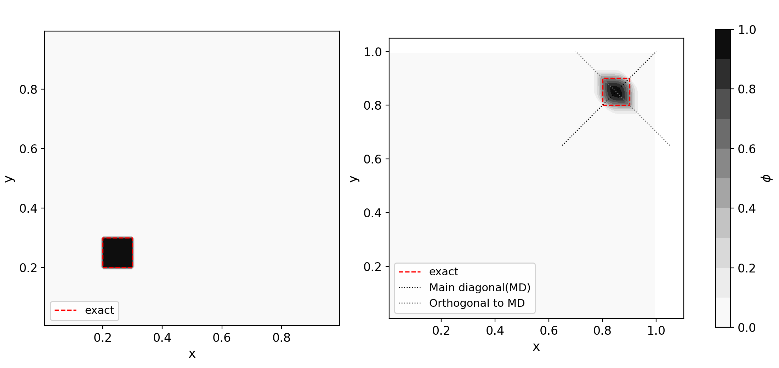
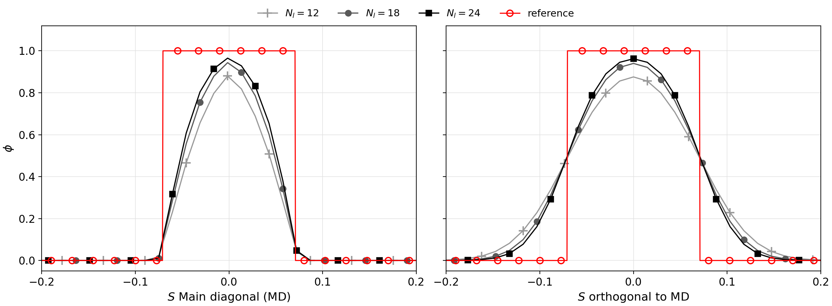
Particle advection - Splicing
Three-dimensional mechanism represented by a one-dimensional domain.
Total scalar is conserved by the particle method
Diffusion is orthogonal to the mean flow direction.
Notable effect of the number of particles.
Advection of a square-shaped scalar field
Scalar field along the main flow direction (left) and orthogonal direction (right) for different numbers of particles.

Slide 7
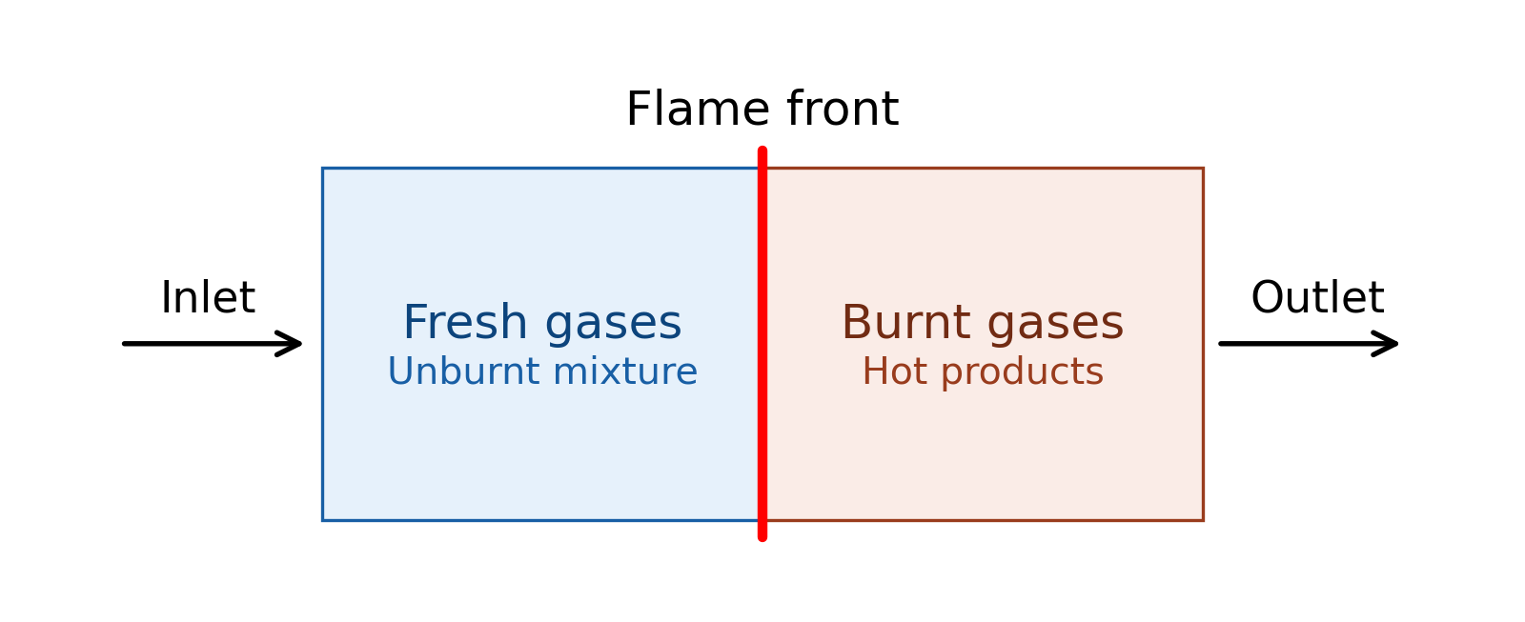
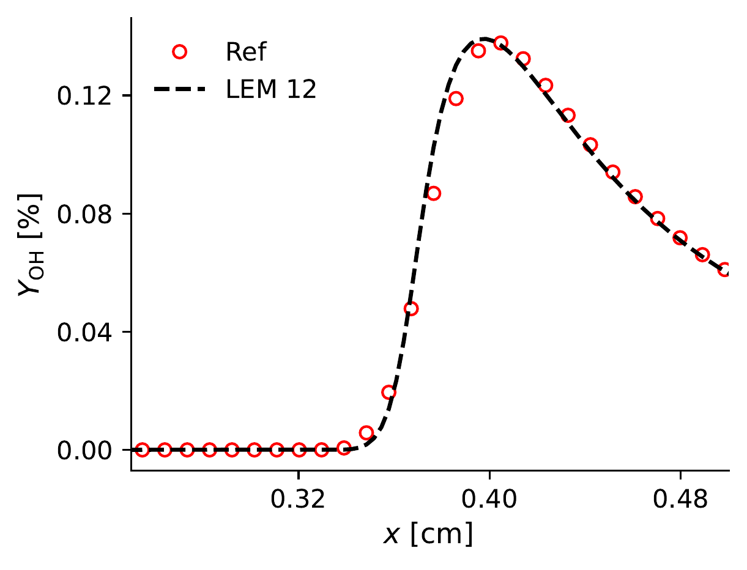
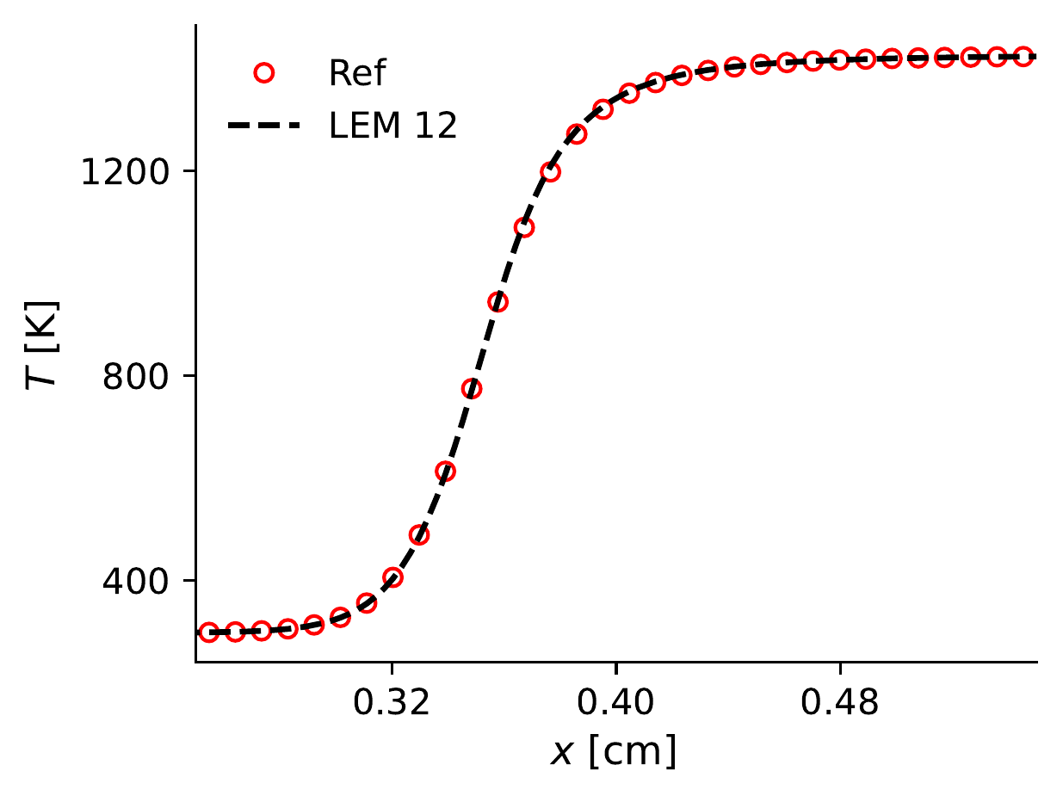
Premixed flame - PMF
Lean premixed flame, φ = 0.4, 300 K, 1 atm: 128 cells × 12 particles against a 512-cell reference
The energy-consistent coupling strategy is validated.
A small shift in the mass species curve is due to the splicing operator.
Chemical heat release is accounted for in the particle internal energy.
Schematic of the flow configuration
CLEM coupling update (mass-weighted)
φ̃^{n+1} = φ̃* + Δφ_{CLEM}
Δφ_{CLEM} = Σ_{p} m_{p} (φ_{p}^{n+1} − φ_{p}^{n}) / Σ_{p} m_{p}
φ̃* = φ̃^{n} for Y_{k} (not solved by NS)
φ̃* = NS solution for energy
OH mass species (left) and temperature (right) profiles

Slide 8
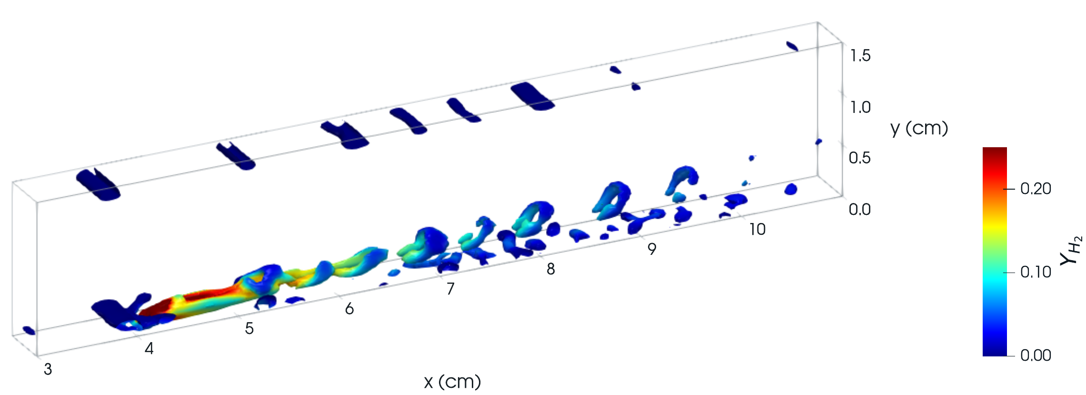
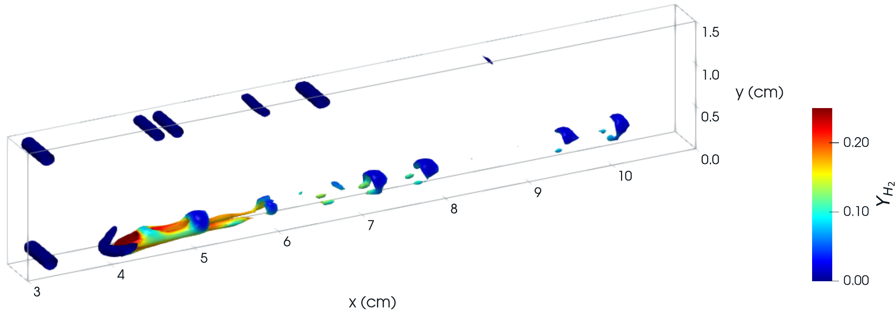
Non-reacting Cross-jet flow
Sonic H₂ jet (D_{j} = 1 mm) into a Mach 1.5 air crossflow at 1000 K, 1 atm (Case 1, Jin et al.)
400 × 48 × 16 cells, 0.3125 mm, no AMR
Hairpin vortices persist to x = 10 cm with WALE-WM, only to x = 8 cm with Smagorinsky.
Q-criterion using WALE (top) and classical Smagorinsky (bottom) model

Slide 9
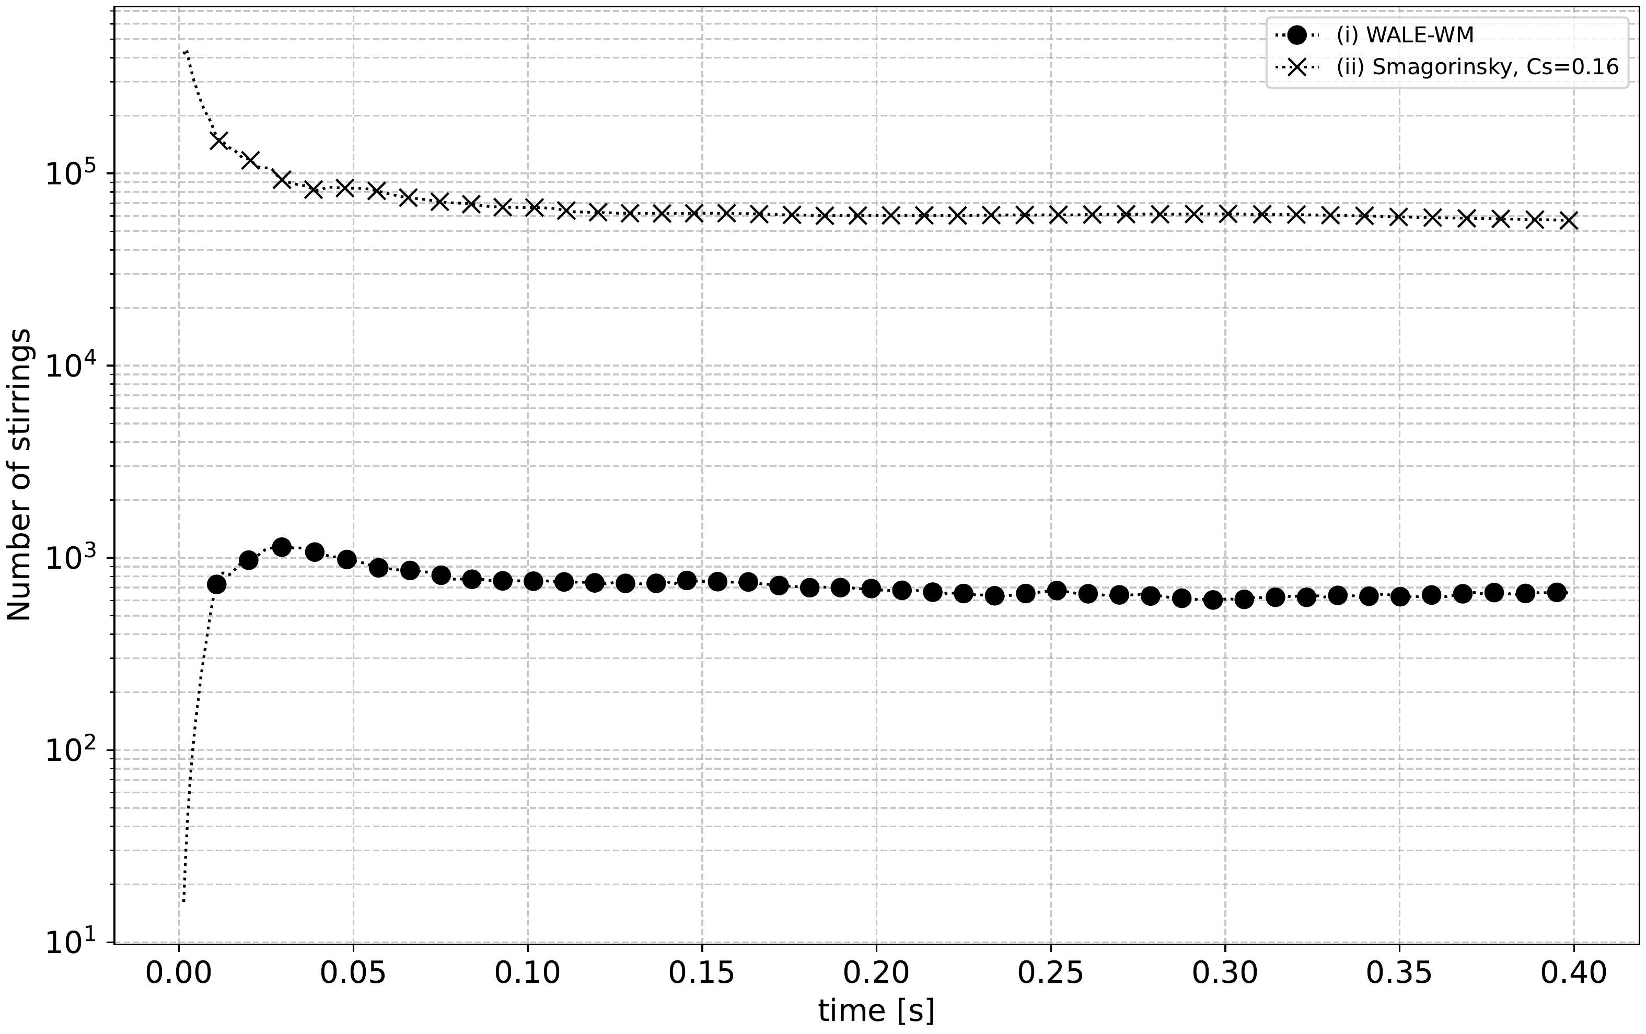
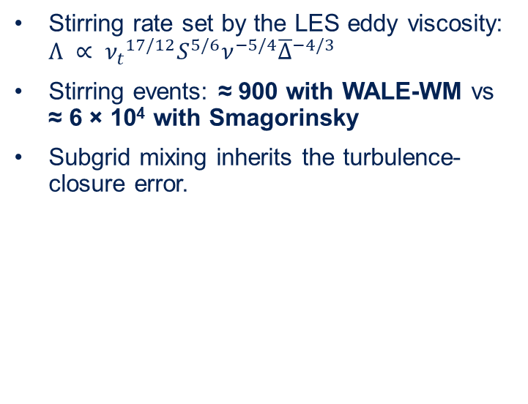
Effect of turbulence closure
Stirring rate set by the LES eddy viscosity: $Λ ∝ {ν_{t}}^{17/12}S^{5/6}ν^{−5/4}{\overline{Δ}}^{−4/3}$
Stirring events: ≈ 900 with WALE-WM vs ≈ 6 × 10⁴ with Smagorinsky
Subgrid mixing inherits the turbulence-closure error.
Number of stirring events per time step using different turbulence closure

Slide 10
Conclusions
P-CLEM is implemented in PeleC with a mass-conserving, energy-consistent coupling.
0D reactor and premixed flame reproduce the references within 0.1 K
Splicing and regridding conserve scalars globally, but add local spurious diffusion.
Subgrid mixing frequency is set by the LES eddy viscosity (Λ ∝ ν_{t}^{17/12}): ≈ 6 × 10⁴ vs ≈ 900. The closure is critical to accurately predict turbulent flames.
Combustion and turbulence closures cannot be assessed independently.
This work is the baseline framework for further development, including AMR in the particle domain to simulate complex flow configurations accurately.
The authors acknowledge the support of the National Council for Science, Technology and Technological Innovation (CONCYTEC, Peru) through the PROCIENCIA program, under the 2025-01 Basic Research Projects call (Contract No. PE501095038-2025-PROCIENCIA)

